Slide 1
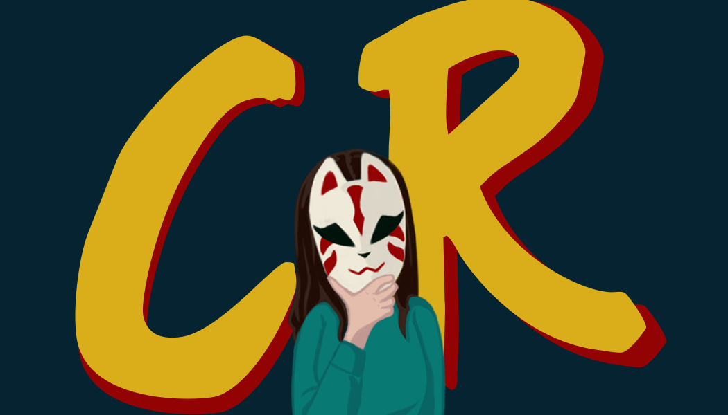
Journey
By Caroline Reilly

Slide 2
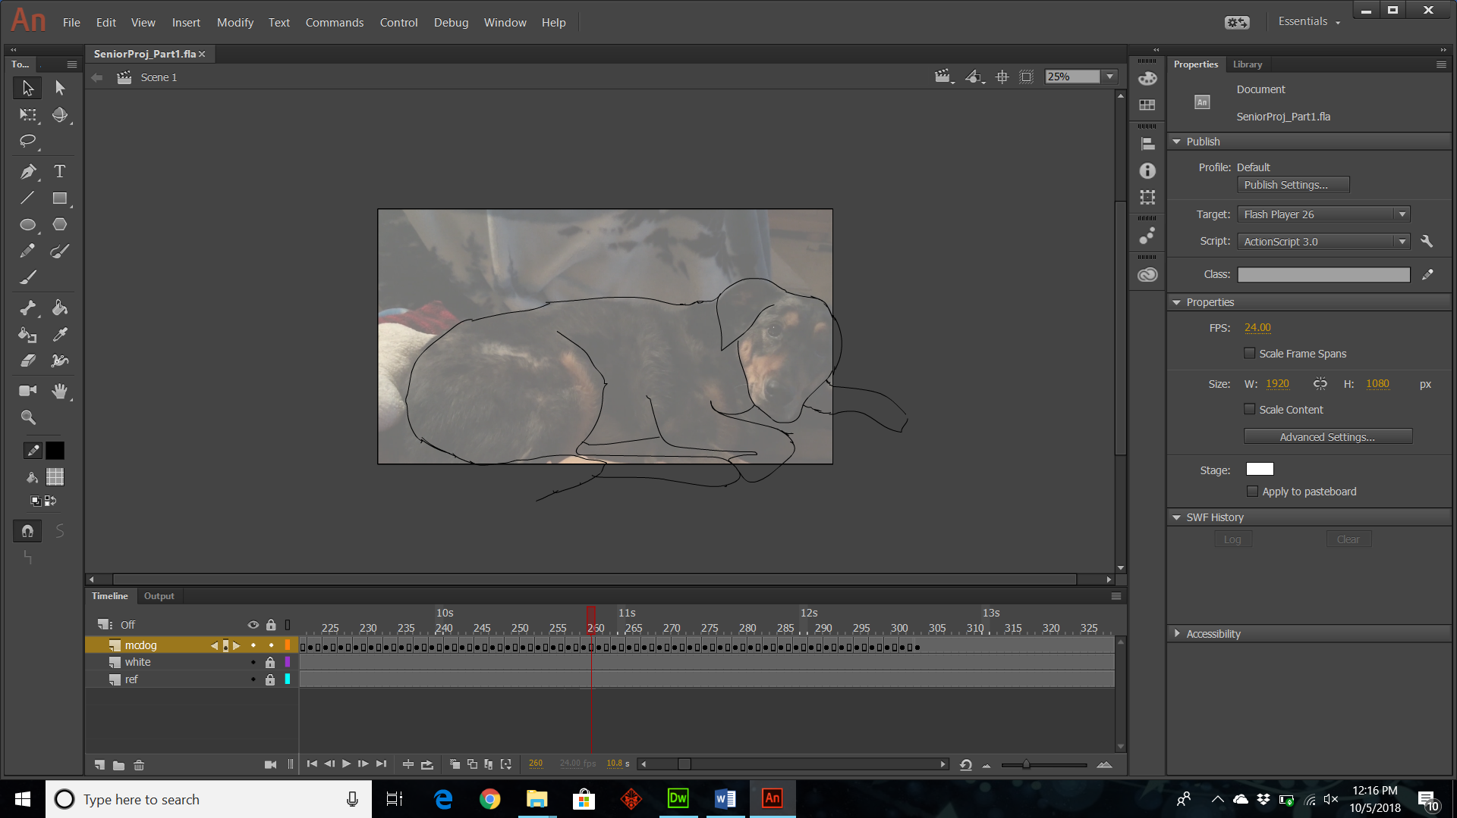
The Beginning of the Journey
Videos were taken of my dog running to get an understanding of how a dog moves
Then came the fun part of getting the videos into Animate (Thank you Dana!)

Slide 3
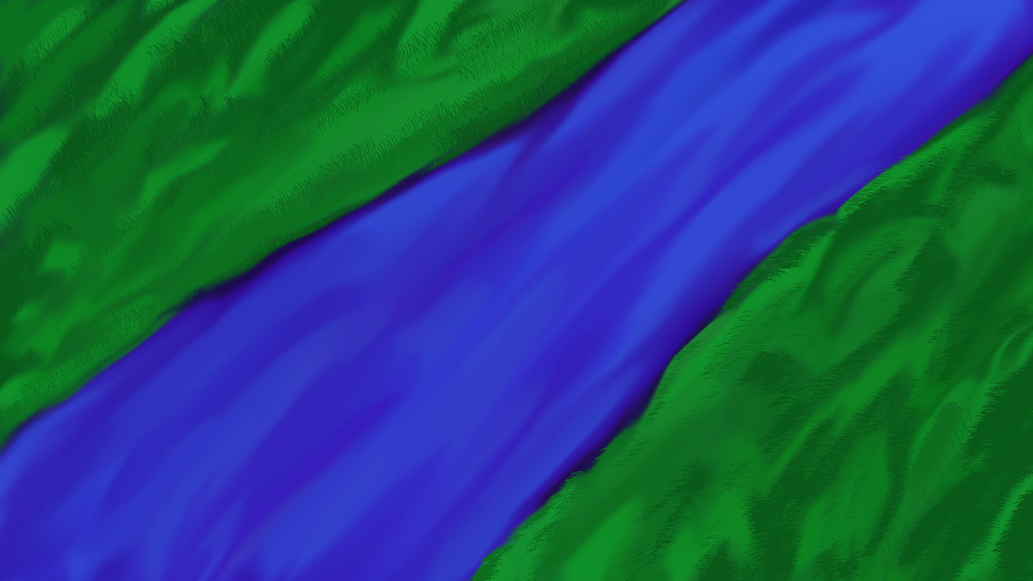
Venturing across the Sea
After drawing many frames (4,200 frames but who's counting), now came the fun part of creating the backgrounds in Photoshop
Many inspirations came from driving around Florida so much when visiting my older sister down in Ft. Lauderdale

Slide 4
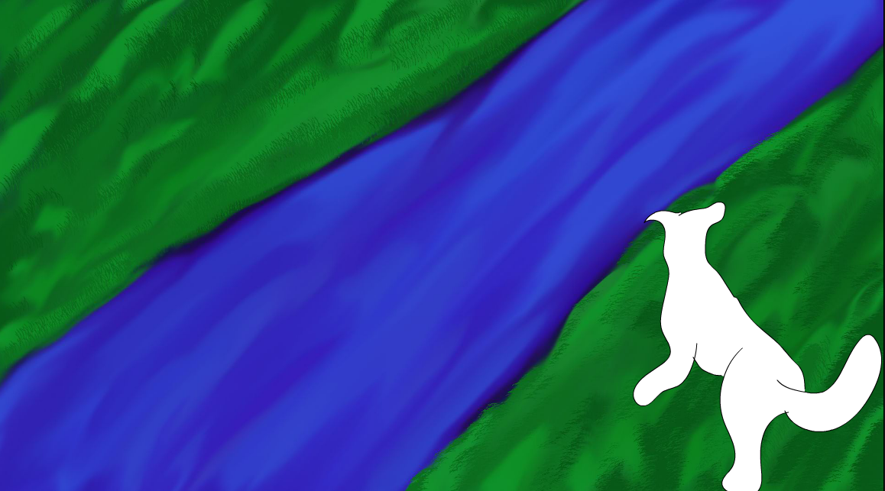
Landfall
After traveling months across the ocean that is Animate it was finally time to combine the backgrounds with the animation (Thank you Ivette!)

Slide 5
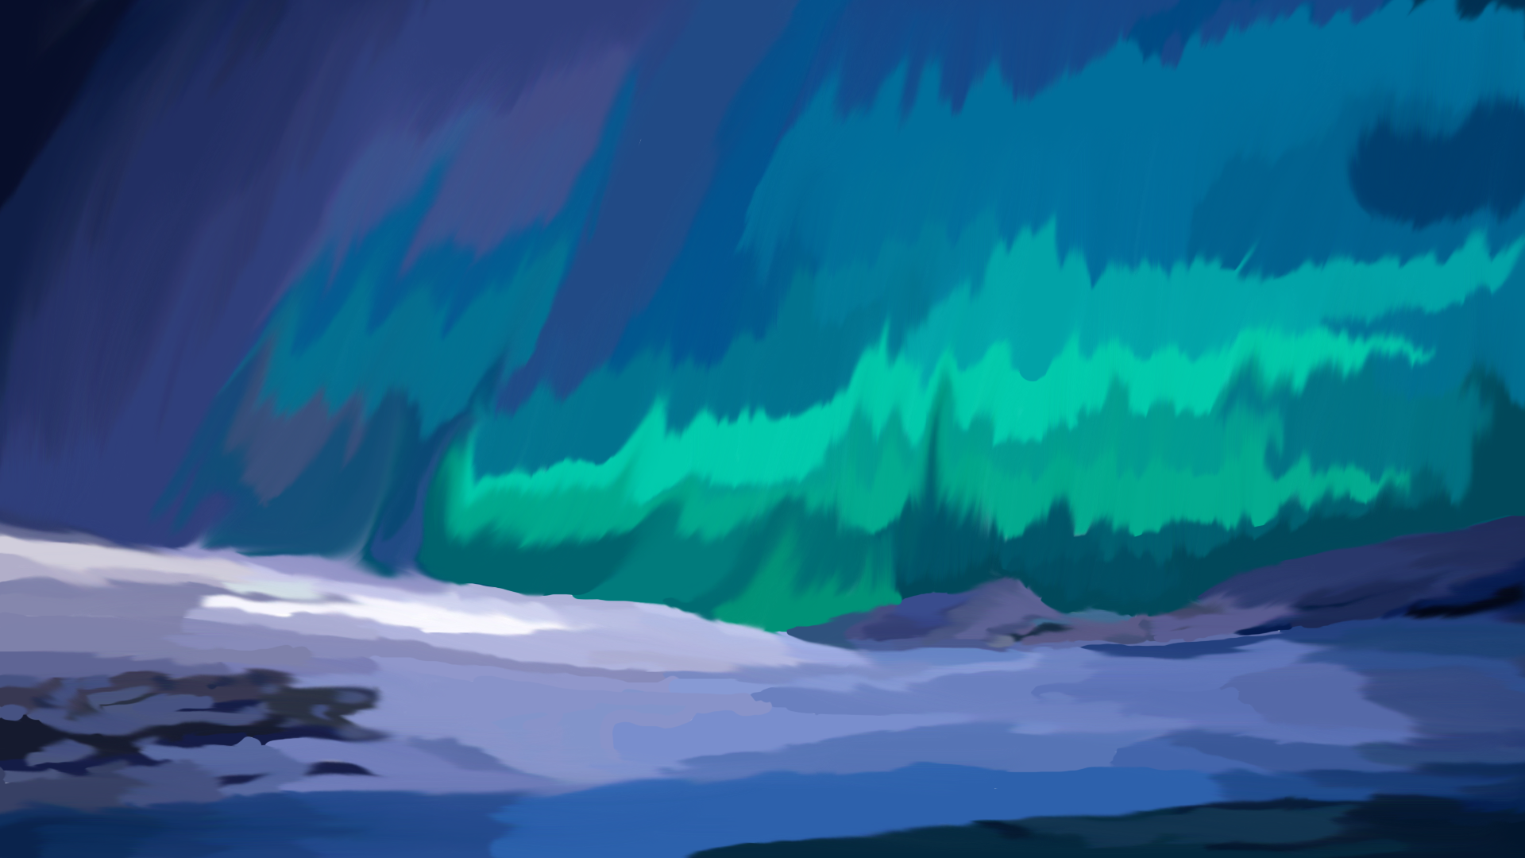
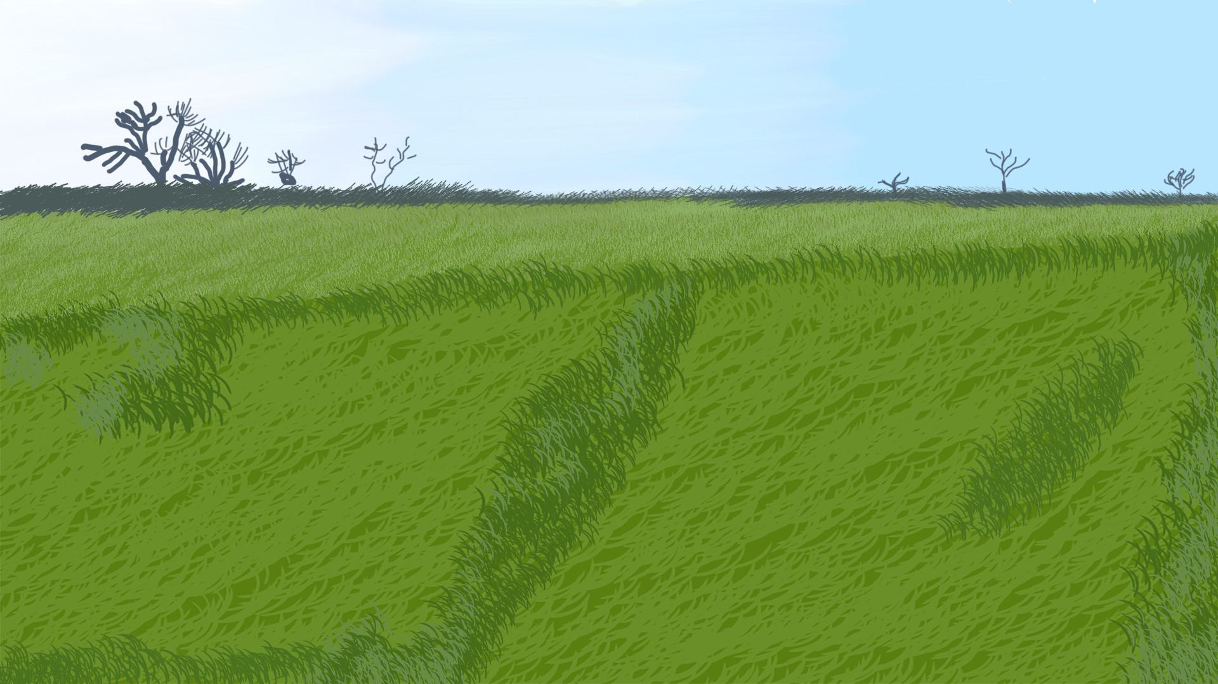
Quest Accepted
Continued working on creating more backgrounds
Creating the aurora borealis was a challenge

Slide 6
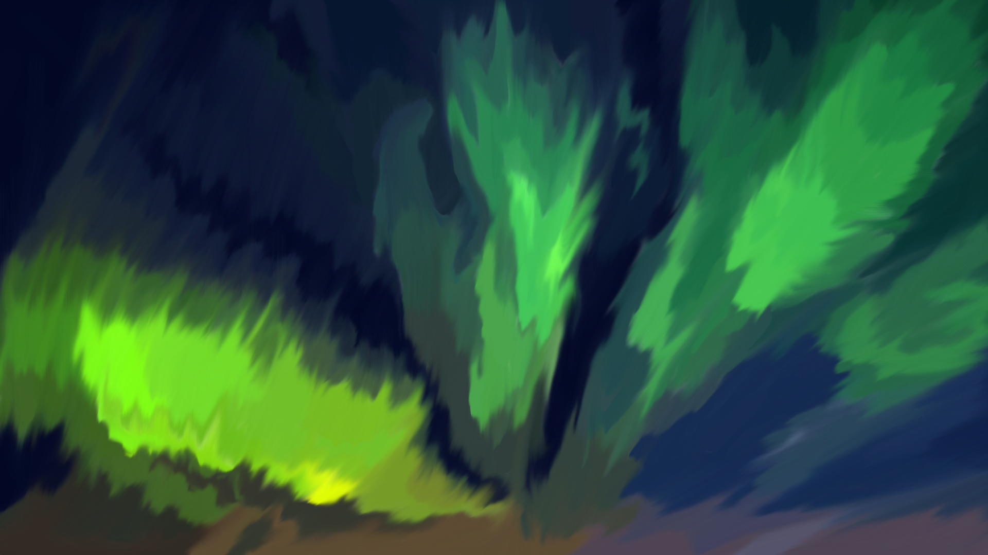
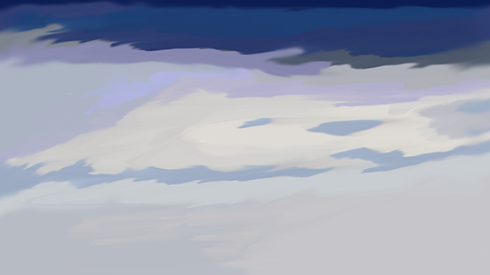
Traveling across the lands
Had to create more backgrounds because I felt there wasn’t enough

Slide 7
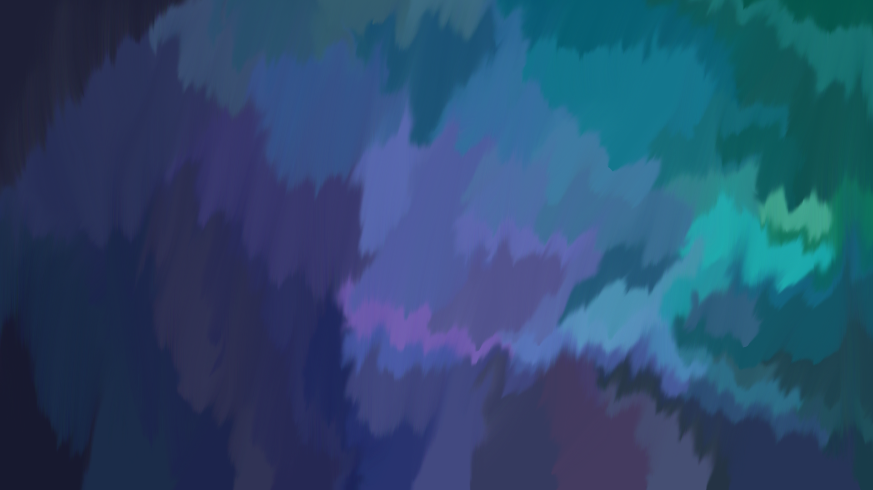
Arrival at the castle
After putting in the backgrounds it was time to export them and edit them in Premiere

Slide 8
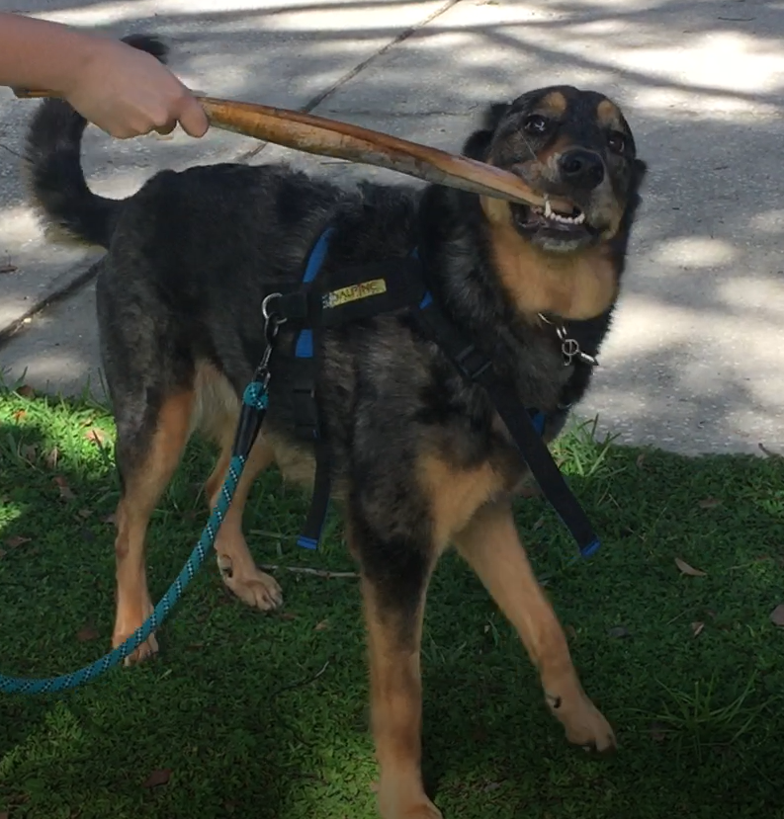
Defeating the demon lord
Finally was able to put in sounds and edit the videos

